Slide 1
Mauryan art
SEM-I
CC-I
TAPASI MAITRA

Slide 2
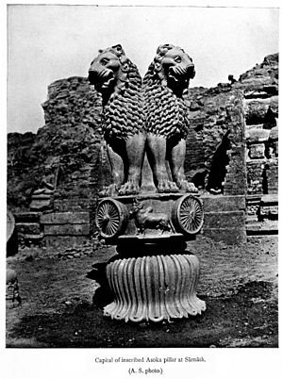
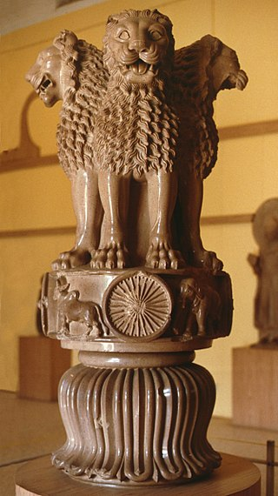
the most famous example of Mauryan art.

Slide 3
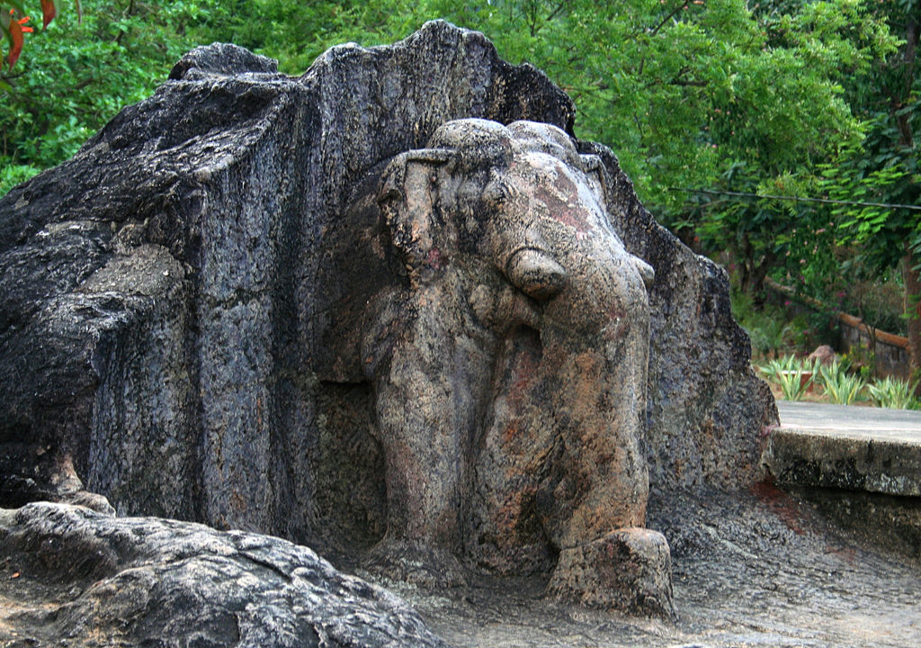
The stone elephant at Dhauli.

Slide 4
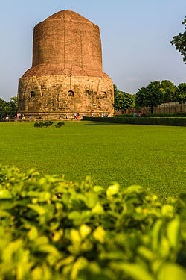
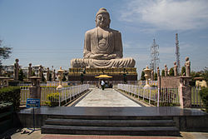
sarnath Historical City
Bodh Gaya

Slide 5
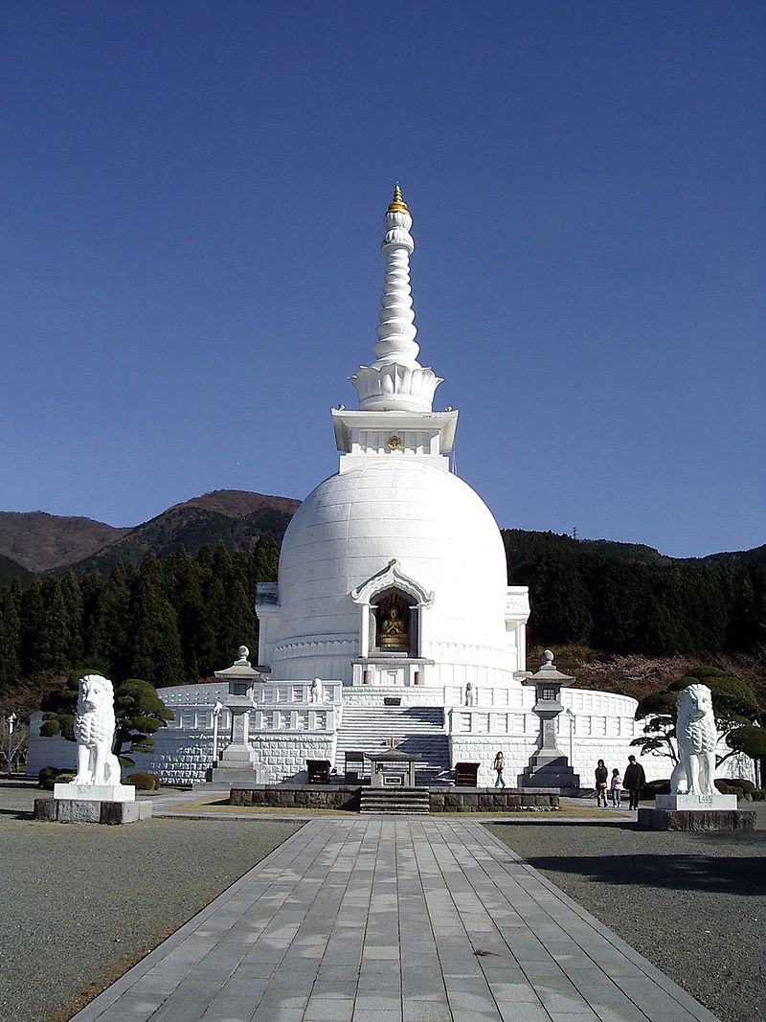
Stupa in Gotemba, Shizuoka, Japan.

Slide 6
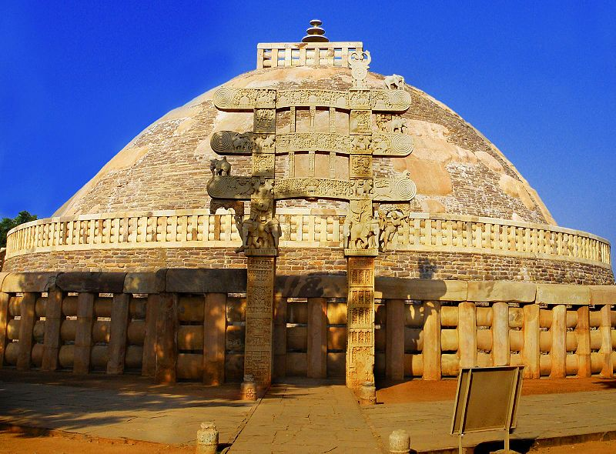
The main Sanchi Stupa from the Eastern gate, in Madhya Pradesh, which contain the relics of Gautam Buddha.

Slide 7
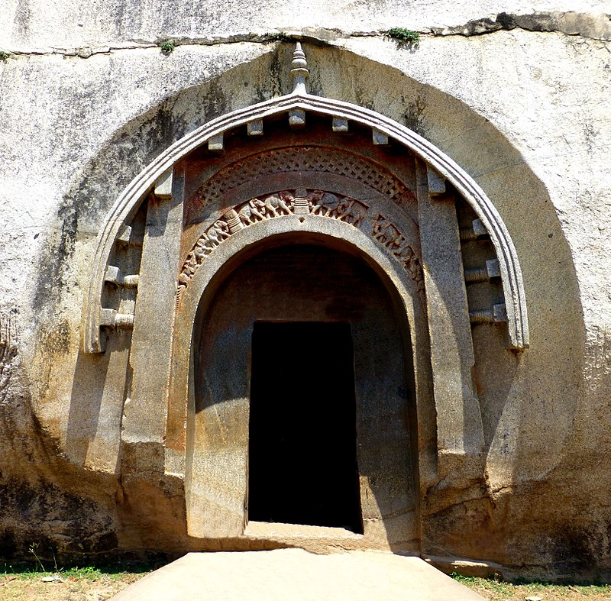
Architecture
Mauryan architecture in the Barabar Mounts. Grottoe of Lomas Rishi. 3rd century BCE.

Slide 8
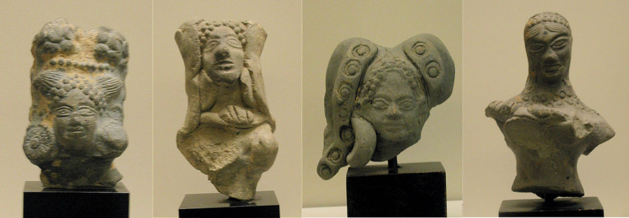
Examples of popular art
Statuettes of the Mauryan era

Slide 9
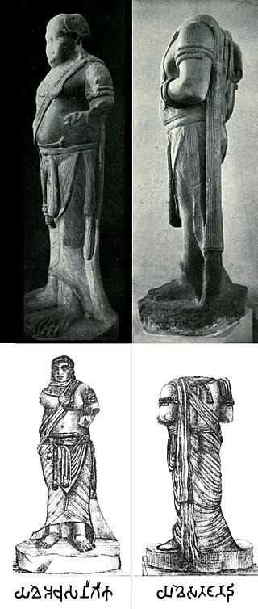
The two monumental Yakshas discovered in Patna (photos and drawings, size: 2 meters tall), and thought to be 3rd century BCE. Left statue inscription: "Yakhe Achusatigika". Right statue inscription: "Yakhe Sanatananda".

Slide 10
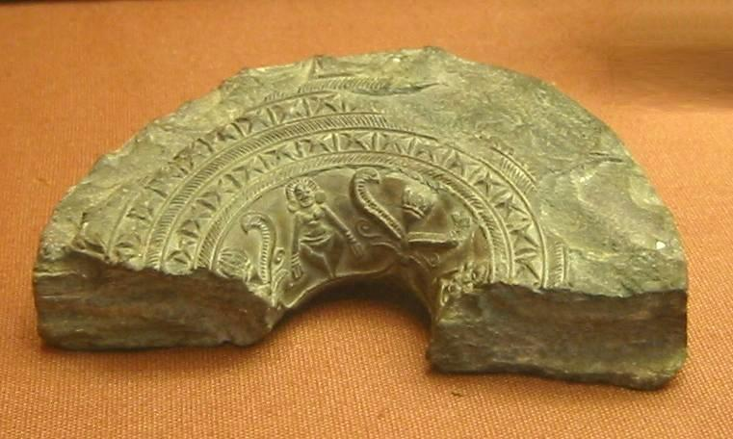
Mauryan ringstone, with standing goddess. Northwest Pakistan. 3rd Century BCE

Slide 11
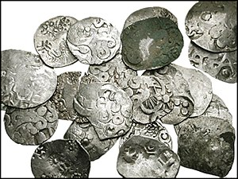
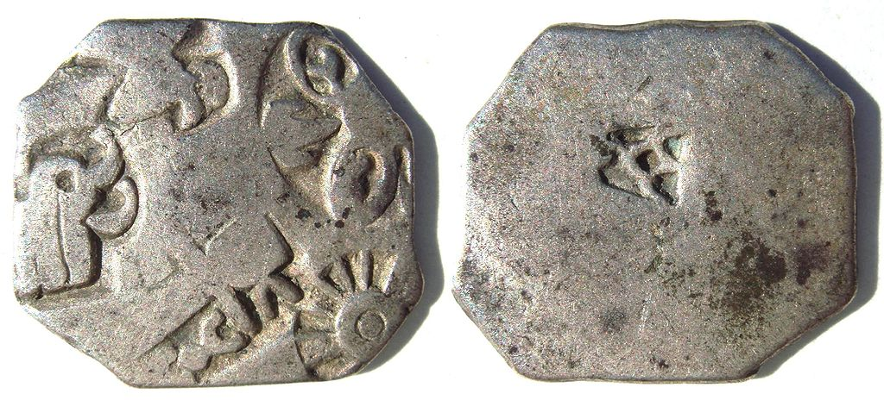
Coins
Karshapana
Silver punch marked coin of the Mauryan empire, with symbols of wheel and elephant (3rd century BCE)

Slide 12
